Slide 1
Pricing Strategies: The Basics
RSM 5010

Slide 2
Review from last time
Revenue decreases with the price if demand is elastic
Revenue increases with price if demand is inelastic
Let’s see that in action in an example with linear demand.

Slide 3
Elasticity, Total Revenue and Linear Demand
P
TR
100
0
10
20
30
40
50
Q
0
Q

Slide 4
Elasticity, Total Revenue and Linear Demand
P
TR
100
80
800
0
10
20
30
40
50
Q
0
10
20
30
40
50
Q

Slide 5
Elasticity, Total Revenue and Linear Demand
P
TR
100
80
60
1200
800
0
10
20
30
40
50
Q
0
10
20
30
40
50
Q

Slide 6
Elasticity, Total Revenue and Linear Demand
P
TR
100
80
60
1200
40
800
0
10
20
30
40
50
Q
0
10
20
30
40
50
Q

Slide 7
Elasticity, Total Revenue and Linear Demand
P
TR
100
80
60
1200
40
20
800
0
10
20
30
40
50
Q
0
10
20
30
40
50
Q

Slide 8
Elasticity, Total Revenue and Linear Demand
P
TR
100
Elastic
80
60
1200
40
20
800
0
10
20
30
40
50
Q
0
10
20
30
40
50
Q
Elastic

Slide 9
Elasticity, Total Revenue and Linear Demand
P
TR
100
Elastic
80
60
1200
Inelastic
40
20
800
0
10
20
30
40
50
Q
0
10
20
30
40
50
Q
Elastic
Inelastic

Slide 10
Elasticity, Total Revenue and Linear Demand
P
TR
100
Elastic
Unit elastic
80
Unit elastic
60
1200
Inelastic
40
20
800
0
10
20
30
40
50
Q
0
10
20
30
40
50
Q
Elastic
Inelastic

Slide 11
Now: Profit maximization, balancing two parts
Revenue
Cost
Which we’ll discuss in more detail
Which we know is related to demand and elasticity

Slide 12
Revenues
For now, firm sells a good at a single price per unit
In that case, total revenues are simple
REVENUE=PRICE x QUANTITY

Slide 13
Revenue and Profit
Remember, this is only half of the story for profits; you also have to think about costs
Throughout, as we did all the way back to GM truck coupons, PROFITS=REVENUE - COST

Slide 14
Motivating example
P = 120, Q =10K, Elasticity = -3,
Suppose each unit costs 100 to produce
(lots more on costs soon)
Is the price maximizing profits?
(In other words, are we producing the right amount?)
If not, should we increase it or decrease the price?
If -3 were the elasticity everywhere, what price should we choose?
What if elasticity were -5?
WE HAVE ENOUGH INFORMATION TO ANSWER ALL OF THESE

Slide 15
Profit Maximization and Marginal Analysis
When considering whether or not price/quantity should be changed, ask two questions : suppose you sold one more unit. How would total revenue change? How would cost change?
If revenue increase is greater than cost increase, sell more
Costs are economic costs, so they include all relevant parts
If revenue increase is less than cost increase, probably should have sold less; selling one FEWER unit probably would have saved more in cost than its revenue generated

Slide 16
This is an important idea that will apply in many contexts
To maximize profits, you must have the additional revenue from selling one more equal to the cost of producing one more!
If not, you should change the number of units you are selling.
In economics we call this MARGINAL analysis, and it is a big part of “thinking like an economist”: maximize by considering small changes
Not just for simple pricing strategies

Slide 17
The Result: when maximizing profits…
Benefit of Last Unit
Marginal
Revenue
Marginal
Cost
Cost of Last Unit

Slide 18
Price elasticity and Marginal Revenue
How much revenue was added by the last unit?
revenue gained ≈ q∆p > 0
p+∆p
revenue lost ≈ p∆q < 0
p
q-1
q

Slide 19
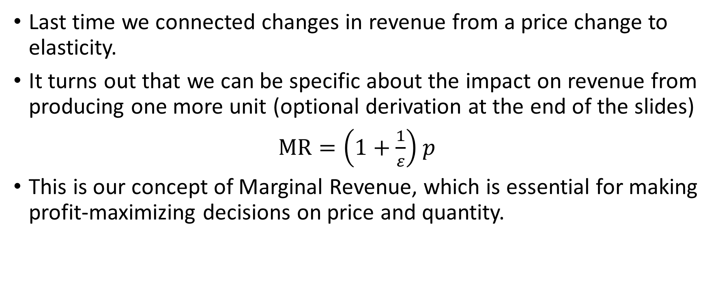
Marginal Revenue
Last time we connected changes in revenue from a price change to elasticity.
It turns out that we can be specific about the impact on revenue from producing one more unit (optional derivation at the end of the slides)
$MR=\left(1+\frac{1}{ε}\right)$ $p$
This is our concept of Marginal Revenue, which is essential for making profit-maximizing decisions on price and quantity.

Slide 20
We’re ready to think about pricing strategies
P = 120, Q =10K, Elasticity = -3,
Suppose each unit costs 100 to produce
(lots more on costs soon)
Is the price maximizing profits?
(In other words, are we producing the right amount?)
If not, should we increase it or decrease the price?
If -3 were the elasticity everywhere, what price should we choose?
What if elasticity were -5?
WE HAVE ENOUGH INFORMATION TO ANSWER ALL OF THESE

Slide 21
Answer: An Overview
What do we know about MR?
We can compute it from elasticity and price
What do we know about MC?
Here, every additional unit costs 100, so marginal cost is 100
That’s it; we just use those two pieces to answer all the questions.

Slide 22
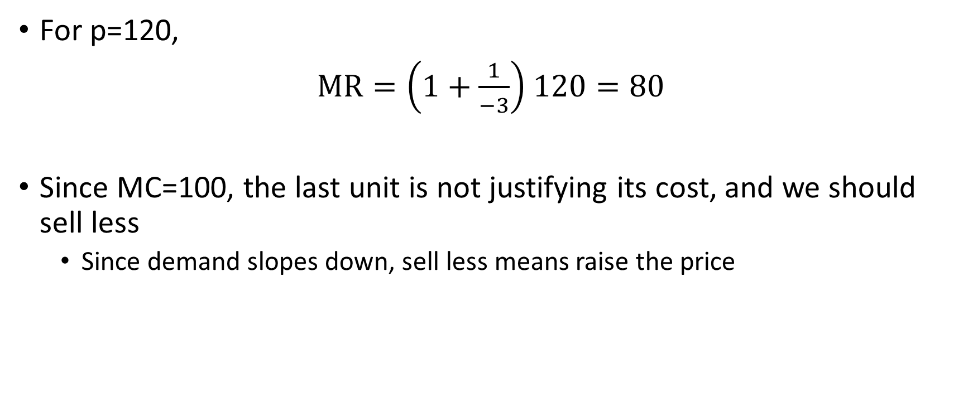
Using the formula
For p=120,
$MR=\left(1+\frac{1}{−3}\right)$ $120=80$
Since MC=100, the last unit is not justifying its cost, and we should sell less
Since demand slopes down, sell less means raise the price

Slide 23
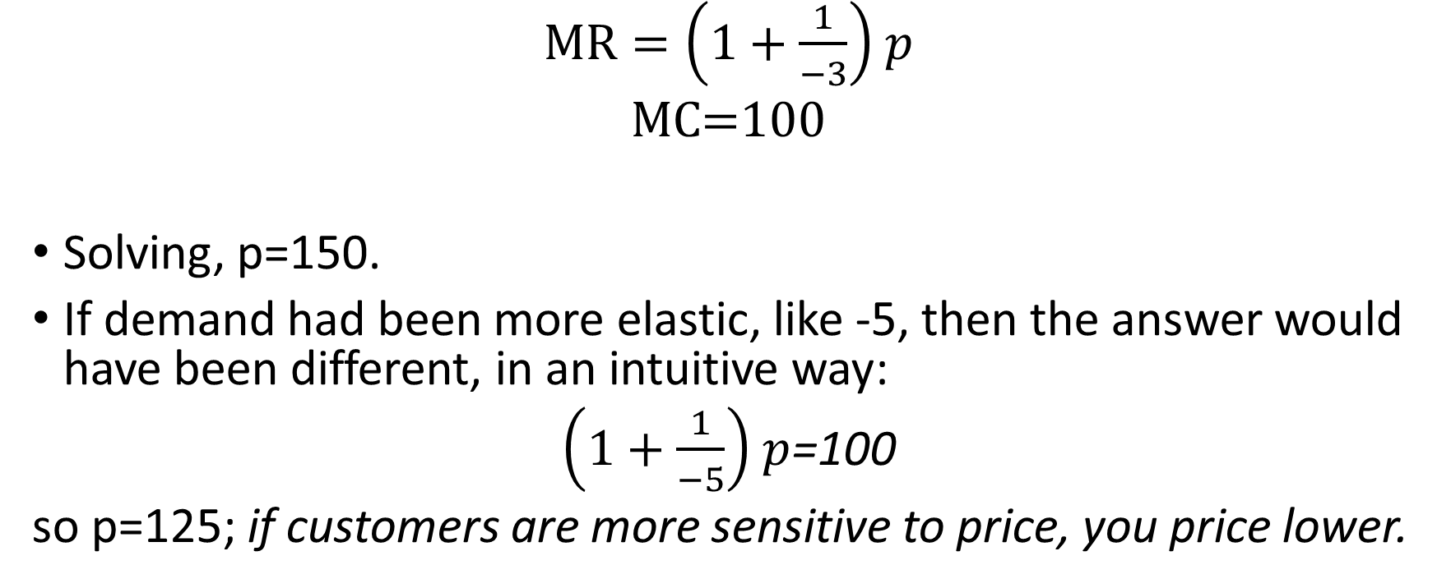
If the elasticity applies everywhere…
$MR=\left(1+\frac{1}{−3}\right)$ $p$
MC=100
Solving, p=150.
If demand had been more elastic, like -5, then the answer would have been different, in an intuitive way:
$\left(1+\frac{1}{−5}\right)$ $p$=100
so p=125; if customers are more sensitive to price, you price lower.

Slide 24
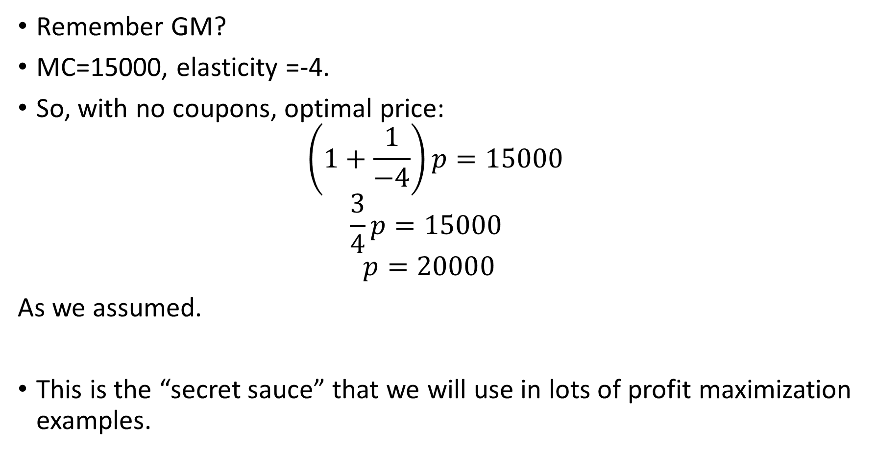
An “Old” Problem
Remember GM?
MC=15000, elasticity =-4.
So, with no coupons, optimal price:
$$\left(1+\frac{1}{−4}\right)p=15000$$
$$\frac{3}{4}p=15000$$
$$p=20000$$
As we assumed.
This is the “secret sauce” that we will use in lots of profit maximization examples.

Slide 25
Two Big Takeaways Today: Profit Maximization
If you know p and elasticity, you know MR
If you want to profit maximize, set MR=MC

Slide 26
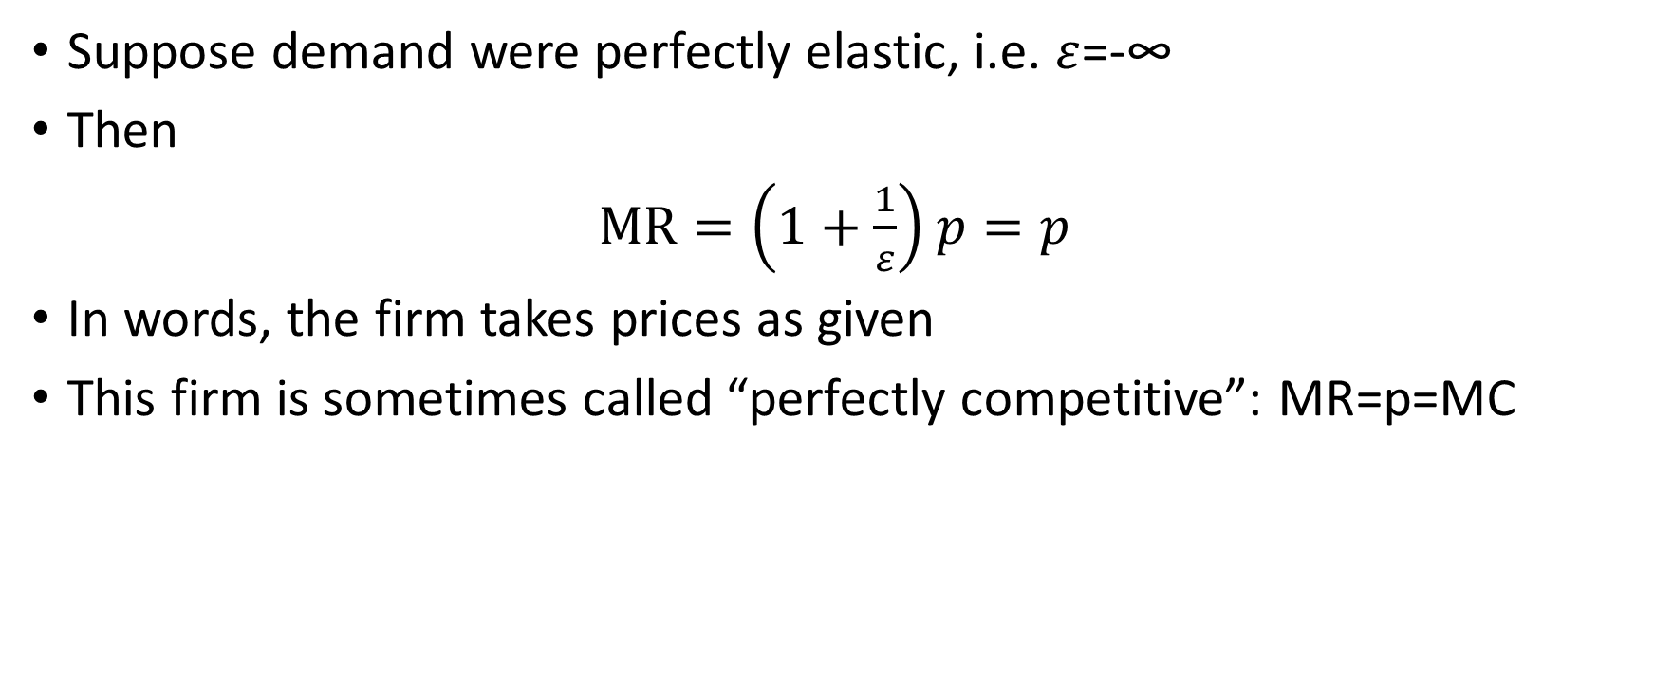
Elasticity of Firm Demand Measures Competition
Suppose demand were perfectly elastic, i.e. $ε$=-∞
Then
$MR=\left(1+\frac{1}{ε}\right)$ $p=p$
In words, the firm takes prices as given
This firm is sometimes called “perfectly competitive”: MR=p=MC

Slide 27
Firms with Market Power
If elasticity of firm demand for a firm is not minus infinity, it has market power
Big question for a firm with market power: how many customers do you lose if you raise the price?
Of course, your competitors matter for this: elasticity of firm’s demand depends on how willing customers are to switch to alternatives (c.f. GM)

Slide 28
Monopoly: The Extreme case
Single firm serves the “relevant market.”
Most monopolies are local monopolies, i.e. the relevant market is limited.
This definition doesn’t really matter; how much market power a firm has is defined by its firm demand curve
I don’t focus on the word “monopoly.”

Slide 29
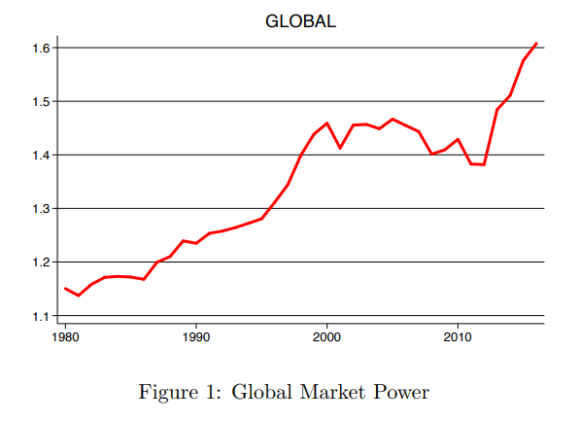
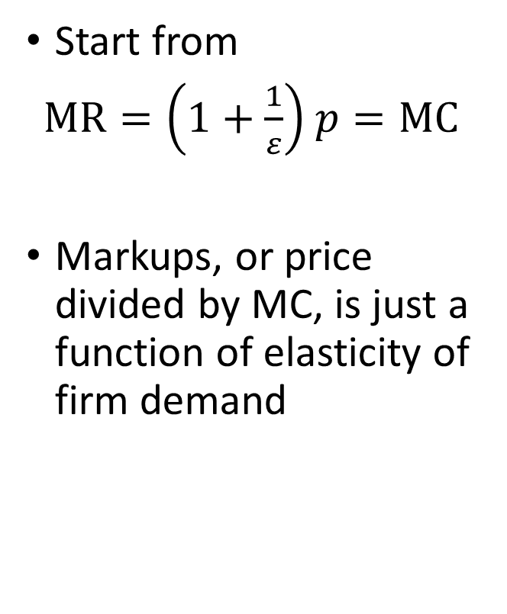
Market Power over Time: De Loecker and Eeckhout (2022)
Start from
$MR=\left(1+\frac{1}{ε}\right)$ $p=MC$
Markups, or price divided by MC, is just a function of elasticity of firm demand

Slide 30
“Natural” Sources of Market Power
Economies of scale
Historically: railroads, oil
Modern data driven companies like Google, Facebook
Economies of scope
Google search and maps
In many cases “data is the new oil” applies to market power as well

Slide 31
“Created” Sources of Market Power
Patents and other legal barriers (like licenses)
Exclusive contracts
Collusion
For an interesting example in a technology sector, specifically how emails are handled, see
https://twitter.com/cfenollosa/status/1566484145446027265
Contract...
I.
II.
III.

Slide 32
Managers have a big impact on this
Insight in recent work of Bao et al. (2022) (Are Managers Paid for Market Power?): “Top firms hire managers to differentiate from direct competitors”
“I don’t want a business that’s easy for competitors. I want a business with a moat around it. [...] Our managers of the businesses we run, I’ve got one message for them, which is to widen the moat.” Warren Buffett, 2007
Contract...
I.
II.
III.

Slide 33
Now some more about costs
What are economic costs?
Fixed and Marginal Cost

Slide 34
Economic costs are not the same as accounting costs
Opportunity costs: the benefits forgone by choosing one course of action instead of another
For example, the “implicit costs” faced by our money manager
If there are many alternative options, opportunity costs are the value of the best option among them
Opportunity costs, though implicit and not included in accounting costs, matter for decision making, and therefore are included in economic costs

Slide 35
An important way to categorize economic costs
Fixed Costs
Same amount no matter what quantity
Defined over some time period and market (see next example)
Marginal cost
The extra cost incurred for each additional unit
We’ve been using a constant number, for simplicity, but in practice this eventually is an increasing function (overtime of workers, constraints in production, etc)
When you add together marginal costs of all units, this is called variable costs, but I want to keep the terminology streamlined for this short course.

Slide 36
Example: Ice-cream costs
Jack rents a truck, buys ice-cream wholesale, and keeps all of the profits. Plans to operate for one hour.
Fixed cost (truck rental and Jack’s time, an opportunity cost): $15/hour
Ice cream: $3 per unit (i.e. marginal cost is 3)

Slide 37
Example: Ice-cream costs
Quantity | Total Cost
0 | 15.00
1 | 18.00
2 | 21.00
3 | 24.00
4 | 27.00
5 | 30.00
6 | 33.00
7 | 36.00
8 | 39.00
9 | 42.00
10 | 45.00
11 | 48.00
12 | 51.00
13 | 54

Slide 38
Example: Ice-cream pricing
Jack rents a truck, buys ice-cream wholesale, and keeps all of the profits.
Fixed cost (truck rental): $15/hour
Marginal cost (wholesale cost of ice cream): $3
Demand (per hour): p = 10 – 0.5Q
What price should Jack charge?

Slide 39
Example: Ice-cream pricing
Price | Quantity | Revenue | Incremental Revenue | Total Cost | Incremental Cost | Profit
10.00 | 0 | 0.00 | n/a | 15.00 | n/a | (15.00)
9.50 | 1 | 9.50 | 9.50 | 18.00 | 3.00 | (8.50)
9.00 | 2 | 18.00 | 8.50 | 21.00 | 3.00 | (3.00)
8.50 | 3 | 25.50 | 7.50 | 24.00 | 3.00 | 1.50
8.00 | 4 | 32.00 | 6.50 | 27.00 | 3.00 | 5.00
7.50 | 5 | 37.50 | 5.50 | 30.00 | 3.00 | 7.50
7.00 | 6 | 42.00 | 4.50 | 33.00 | 3.00 | 9.00
6.50 | 7 | 45.50 | 3.50 | 36.00 | 3.00 | 9.50
6.00 | 8 | 48.00 | 2.50 | 39.00 | 3.00 | 9.00
5.50 | 9 | 49.50 | 1.50 | 42.00 | 3.00 | 7.50
5.00 | 10 | 50.00 | 0.50 | 45.00 | 3.00 | 5.00
4.50 | 11 | 49.50 | (0.50) | 48.00 | 3.00 | 1.50
4.00 | 12 | 48.00 | (1.50) | 51.00 | 3.00 | (1.50)

Slide 40
Example: Ice-cream pricing
Price | Quantity | Revenue | Total Cost | Profit
10.00 | 0 | 0.00 | 15.00 | (15.00)
9.50 | 1 | 9.50 | 18.00 | (8.50)
9.00 | 2 | 18.00 | 21.00 | (3.00)
8.50 | 3 | 25.50 | 24.00 | 1.50
8.00 | 4 | 32.00 | 27.00 | 5.00
7.50 | 5 | 37.50 | 30.00 | 7.50
7.00 | 6 | 42.00 | 33.00 | 9.00
6.50 | 7 | 45.50 | 36.00 | 9.50
6.00 | 8 | 48.00 | 39.00 | 9.00
5.50 | 9 | 49.50 | 42.00 | 7.50
5.00 | 10 | 50.00 | 45.00 | 5.00
4.50 | 11 | 49.50 | 48.00 | 1.50
4.00 | 12 | 48.00 | 51.00 | (1.50)
3.50 | 13 | 45.50 | 54 | (8.50)

Slide 41
Example: Ice-cream pricing
Price | Demand | Revenue | Incremental Revenue | Total Cost | Incremental Cost | Profit
10.00 | 0 | 0.00 | n/a | 15.00 | n/a | (15.00)
9.50 | 1 | 9.50 | 9.50 | 18.00 | 3.00 | (8.50)
9.00 | 2 | 18.00 | 8.50 | 21.00 | 3.00 | (3.00)
8.50 | 3 | 25.50 | 7.50 | 24.00 | 3.00 | 1.50
8.00 | 4 | 32.00 | 6.50 | 27.00 | 3.00 | 5.00
7.50 | 5 | 37.50 | 5.50 | 30.00 | 3.00 | 7.50
7.00 | 6 | 42.00 | 4.50 | 33.00 | 3.00 | 9.00
6.50 | 7 | 45.50 | 3.50 | 36.00 | 3.00 | 9.50
6.00 | 8 | 48.00 | 2.50 | 39.00 | 3.00 | 9.00
5.50 | 9 | 49.50 | 1.50 | 42.00 | 3.00 | 7.50
5.00 | 10 | 50.00 | 0.50 | 45.00 | 3.00 | 5.00
4.50 | 11 | 49.50 | (0.50) | 48.00 | 3.00 | 1.50
4.00 | 12 | 48.00 | (1.50) | 51.00 | 3.00 | (1.50)

Slide 42
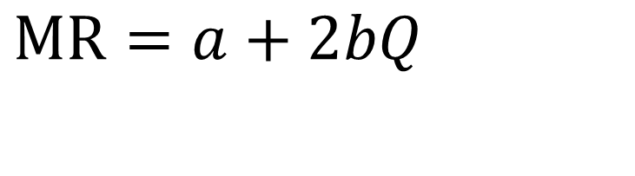

Useful Formulae
Earlier:
$MR=\left(1+\frac{1}{ε}\right)$ $p$
Special one for straight line demand, $P=a+bQ$ :
$$MR=a+2bQ$$

Slide 43
Example: Ice-cream pricing
Recall the ice-cream example with demand function p = 10 – 0.5Q
Marginal revenue: MR = 10 – Q < p
P
10
D: inverse demand curve p(Q)
MR
10
20
Q

Slide 44
Example: Ice-cream pricing
MR = 10 – Q and MC = 3
MR = MC ⇒ 10 – Q = 3 ⇒ Q^{M} = 7
p^{M} = 10 – 0.5Q^{M} = 6.5
π^{M} = p^{M}Q^{M} – (3Q^{M} + 15) = 9.5
P
profit
10
9.5
p^{M}
D: p(Q) = 10 – 0.5Q
MR > MC
MR < MC
3
MC
MR
Q^{M} = 7
10
20
Q
Q^{M} = 7
Q

Slide 45
Average Cost
Average total cost is just total cost/units produced
Therefore total cost is ATC*q
If a firm just has a fixed cost and constant marginal cost, this has to decrease since AC=MC+FC/q
A more realistic picture would have MC increase (at least for high enough q). This would produce AC that is U-shaped, and more realistic
MR=MC is still optimal!

Slide 46
Cost Curves in a General Case
MC
$
Profit
ATC
P^{M}
ATC
D
Q^{M}
Q
MR

Slide 47
Market Power: the big picture
With a simple pricing strategy and market power, a firm can charge a price above marginal cost and make positive economic profits
But we have limitations: the demand curve
In order to charge a higher price, we have to restrict units.
That’s a profitable thing to do, if you are stuck with a simple pricing strategy, but it makes you wonder if there is more that can be done with more sophisticated strategies like targeted prices…

Slide 48
Cost of market power
Inefficiency of market power relative to perfect competition:
Price is above marginal cost ⇒ consumers are worse off
But the firm earns higher profits (i.e., producer surplus)
Which effect dominates?
p
CS
deadweight loss
MC
monopoly price
Negative effect on consumer surplus dominates ⇒ deadweight loss
efficient price
PS
MR
D
monopoly quantity
efficient quantity
Q

Slide 49
Summary
When choosing prices
Want to set marginal revenue = marginal cost
MR comes from one of two formula
Firm with market power and simple pricing strategy produces too little and charges too high a price, which increases profits at the expense of total surplus.
Maybe we can do better with targeted pricing strategies, our next topic
Will still use a lot of the tools of MR=MC and formulas here

Slide 50
Optional: deriving MR
Using similar logic to before: $\frac{ΔR}{R}≈\frac{pΔq+qΔp}{pq}=\frac{Δq}{q}+\frac{Δp}{p}=\left(1+\frac{1}{\frac{Δq}{Δp}\frac{p}{q}}\right)\frac{Δq}{q}=\left(1+\frac{1}{ε}\right)\frac{Δq}{q}.$
But now let $Δq$ be one. Then $ΔR=\left(1+\frac{1}{ε}\right)\frac{R}{q}=\left(1+\frac{1}{ε}\right)$ $p$
This is our concept of Marginal Revenue, which is essential for making profit-maximizing decisions on price and quantity.

